Slide 1
Title: Data Engineer
Author: Satish Nalla

Slide 2
Introduction
Predicting House Prices
Input the Existing Data.
Build the Prediction Model Algorithm using Linea Regression in Python.
Verify the Model.
Test the Model
Conclude.
*Please add slides as required.

Slide 3
The Data
Possible Target Variables
for prediction:
Key Variables of Data:
OverallQual
GrLivArea
YearBuilt
Garage Area
Garage Cars
Total Basement SFT
Garage Year Built
Year Remodel Add
Full Bath
1st Floor SFT
Mas Vnr Area
Total Rooms Above Ground
Fireplaces
Central Air Conditioning
Lot Area
Foundation
Wood Deck SFT
Paved Drive
Exterior 1st
Half Bath
SalePrice
LogSalePrice
SalePricePerSft
LogSalePricePerSft
*Please add slides as required.

Slide 4
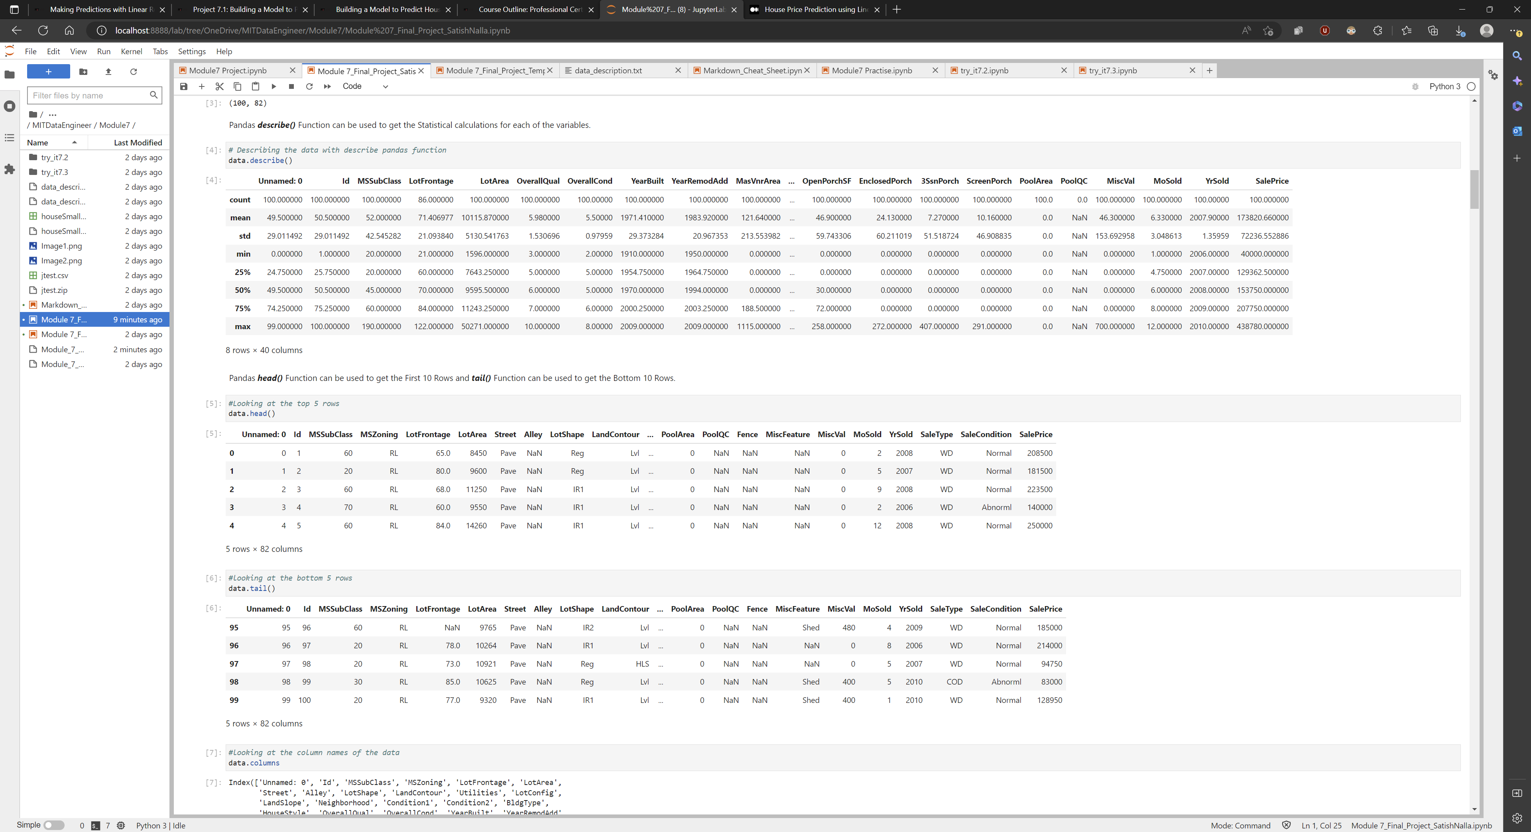
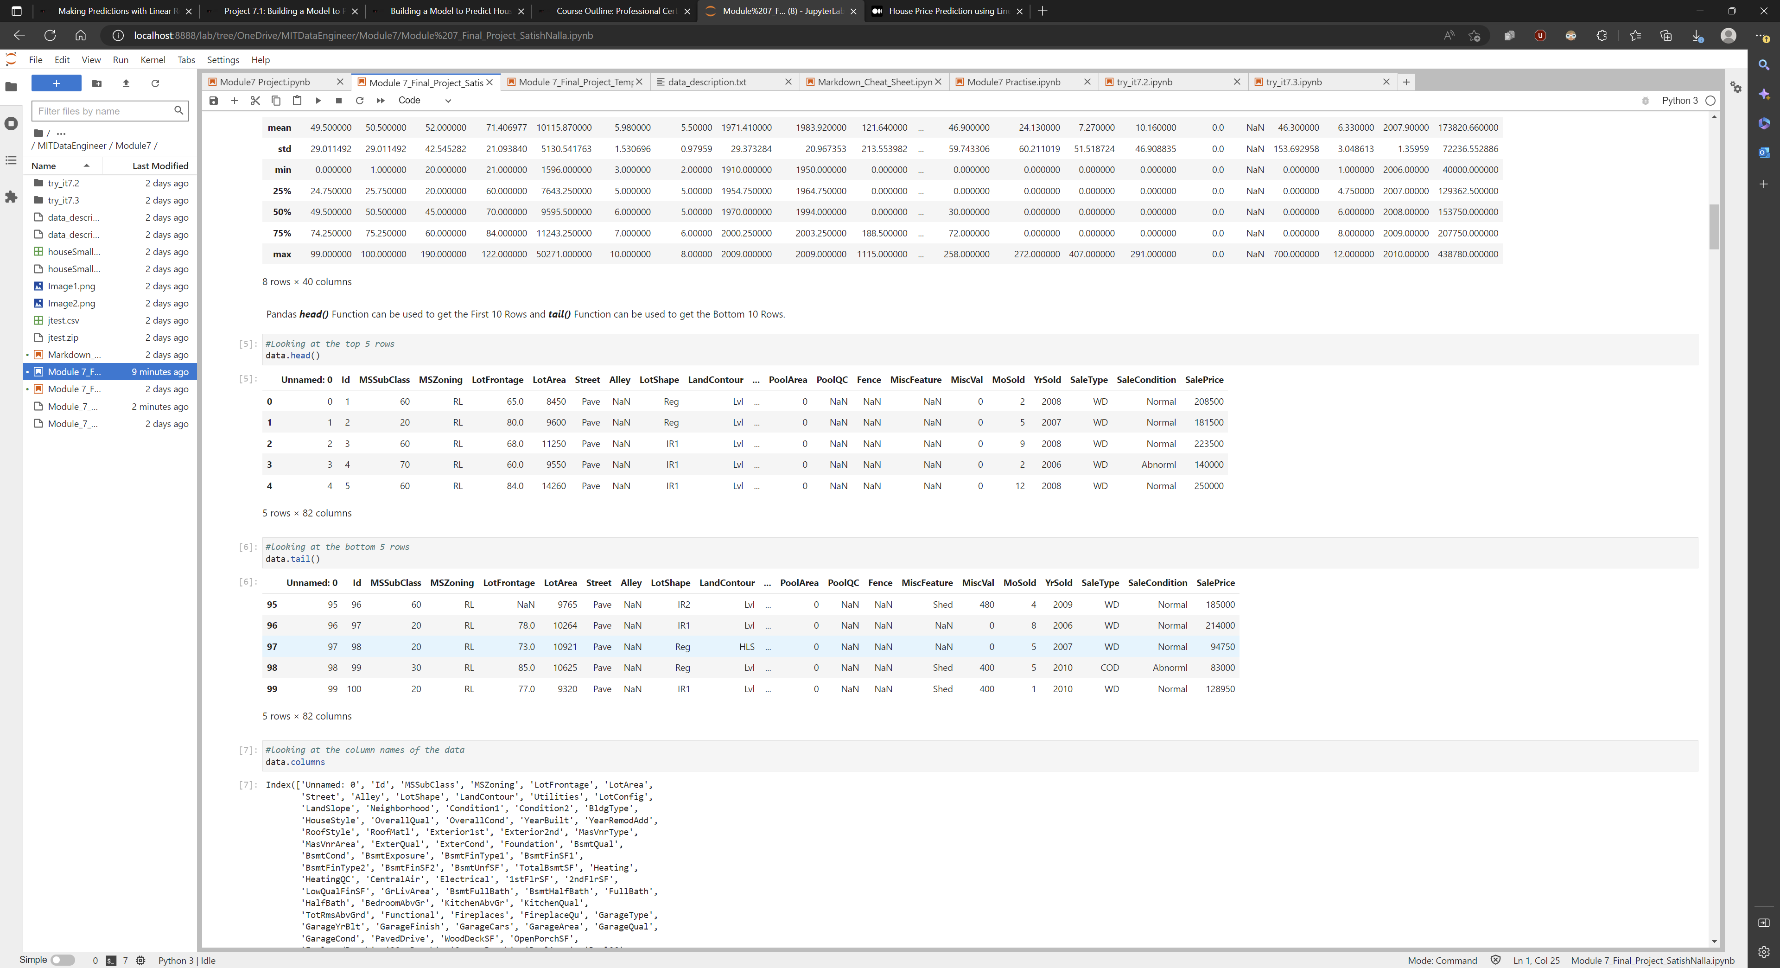
Data Exploration
Data Description
Data Top n Bottom Rows

Slide 5
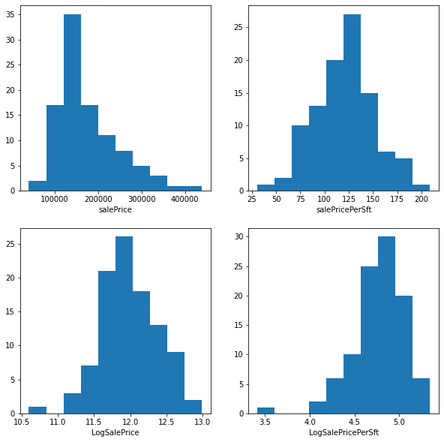
Data Exploration
Target Variables Uniformness of Data
*Please add slides as required.

Slide 6
Data Preparation
Removed the unwanted columns.
Dropping the Excess Null Value columns.
Converting the Text Variables to Number variables using from sklearn module.
*Please add slides as required.

Slide 7
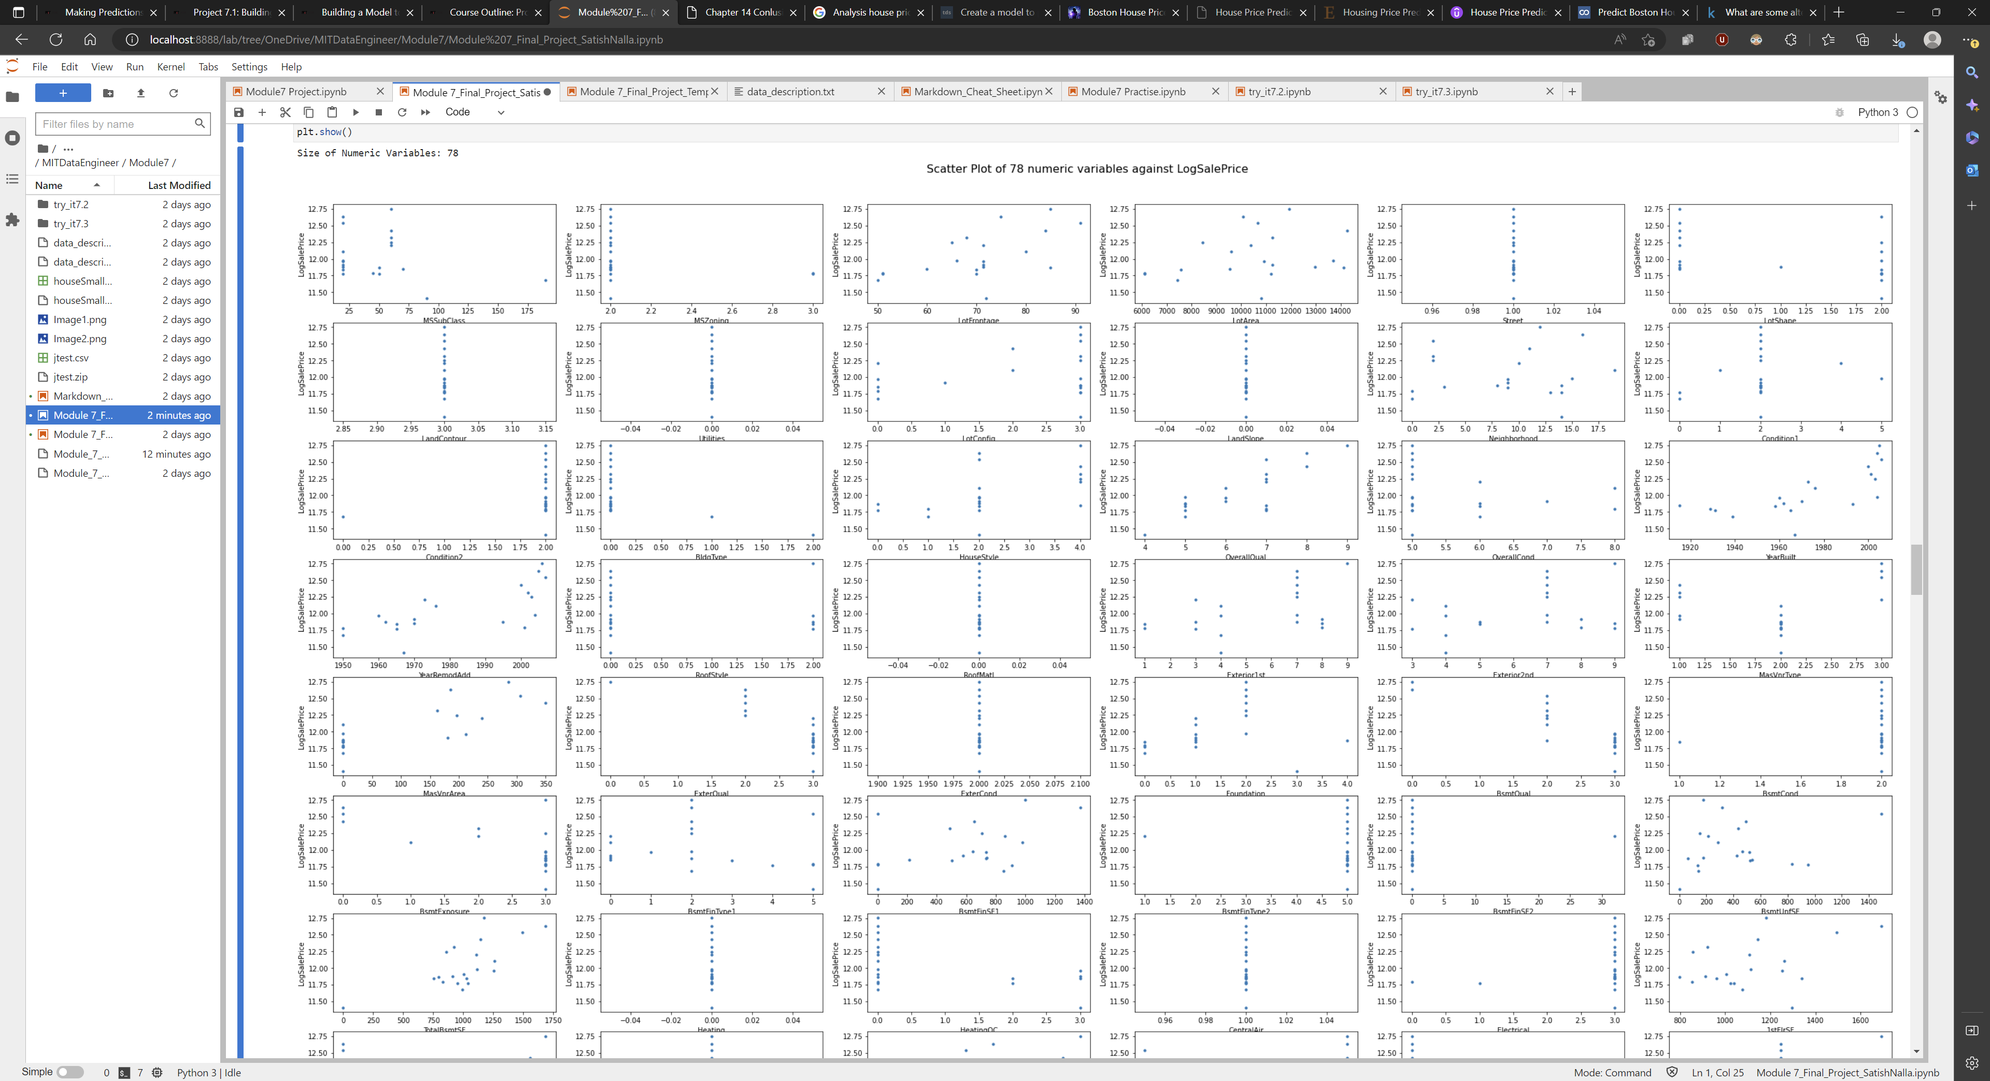
Correlation
Scatter Plot of 78 numeric variables against LogSalePrice
Contd..

Slide 8
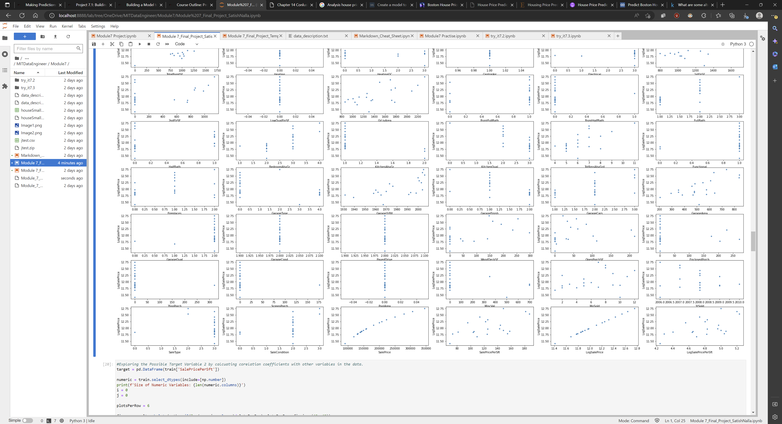
Correlation
Scatter Plot of 78 numeric variables against LogSalePrice

Slide 9
Project Description
After exploring the Data. Target variable looks Linear, hence the Linear Regression Model has been used to predict the House Prices
Using the Below Key Variables to predict LogSalesPrice
OverallQual
GrLivArea
YearBuilt
Garage Area
Garage Cars
Total Basement SFT
Garage Year Built
Year Remodel Add
Full Bath
1st Floor SFT
Mas Vnr Area
Total Rooms Above Ground
Fireplaces
Central Air Conditioning
Lot Area
Foundation
Wood Deck SFT
Paved Drive
Exterior 1st
Half Bath
*Please add slides as required.

Slide 10
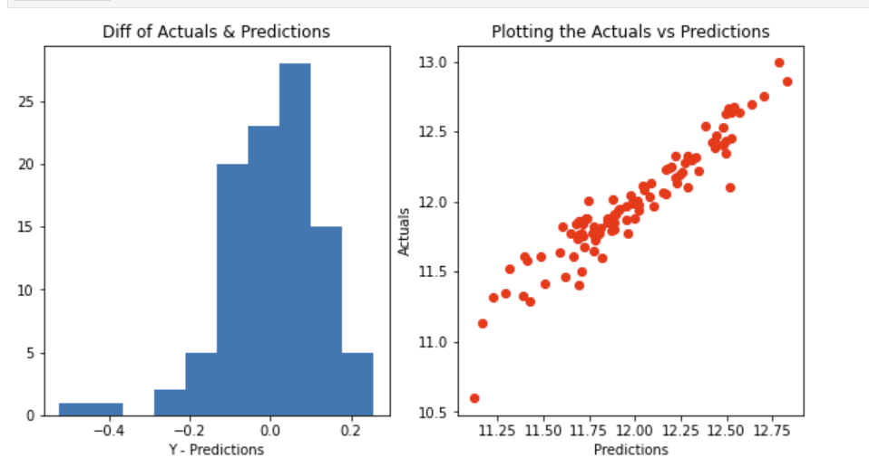
Analysis and Results
After building the model using Linear Regression, Predictions vs Actuals
Result Score: 90%
Intercept: 1.6
*Please add slides as required.

Slide 11
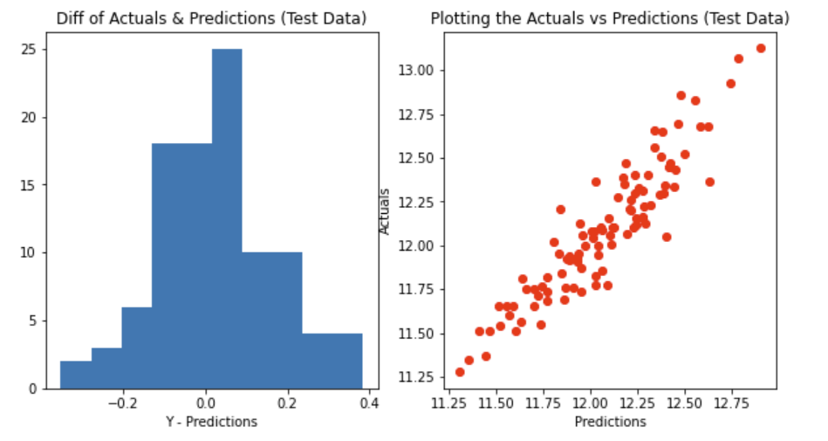
Verification
Result Score with Test Data: 85%
Mean Square Error: 0.35
*Please add slides as required.

Slide 12
Conclusion
Exploration of data analysis is key.
Unforming the targets.
Finalizing the key variables for correlating the data.
Looing for right model to fit for the data.
Train & Build the model.
Test the model and evaluate the results.
*Please add slides as required.

Slide 13
References
References
“Linear Regression.” www.statisticssolutions.com.
Fernando, Jason “Correlation coefficient” The Correlation Coefficient: What It Is, What It Tells Investors www.investopedia.com.
"Scikit-learn" http://scikit-learn.org
*Please add slides as required.

